Slide 1
OHM Sweet Home
Weekly Update 2

Slide 2
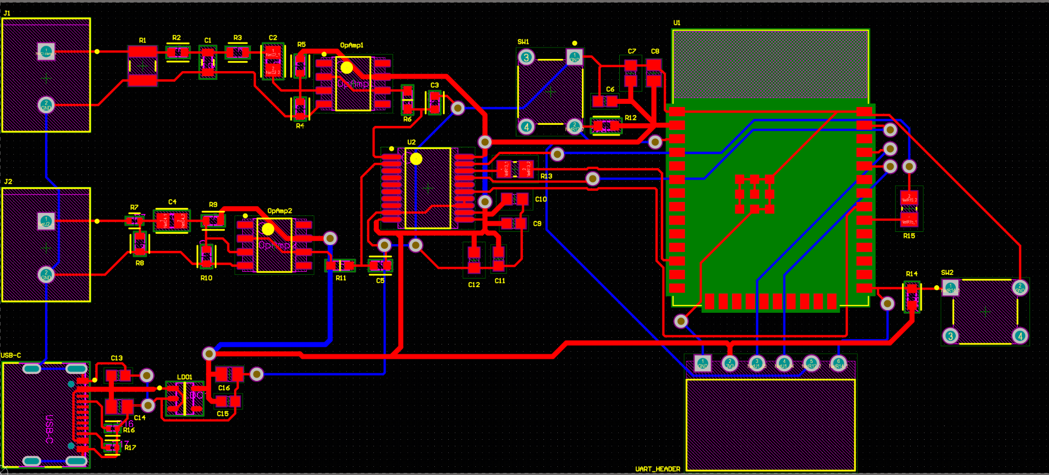
SFE/Signal Conditioning/Embedded Systems
Completed:
Finished schematic designs
Completed PCB design
Addition of Voltage Sensing
Added external ADC
In Progress:
Waiting for PCB approval
Part Order

Slide 3
Machine Learning
Completed:
Setup Google Cloud Run
In Progress:
Verifying the flow of data from ESP -> Cloud -> Database

Slide 4
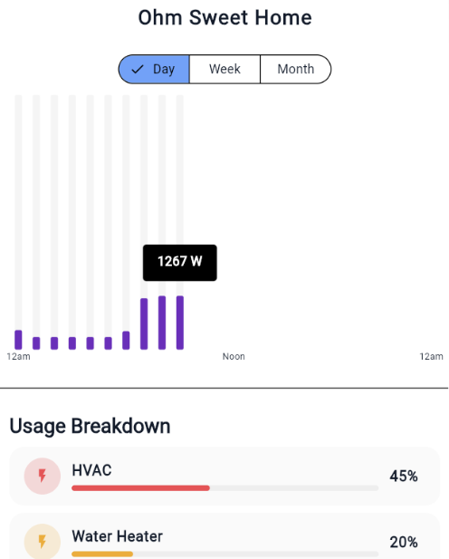
Application Development
Completed: Fixed Backfill Algorithm so the charts don't have empty space in the history char
In Progress: Make it look nicer, work with microcontroller

